Slide 1
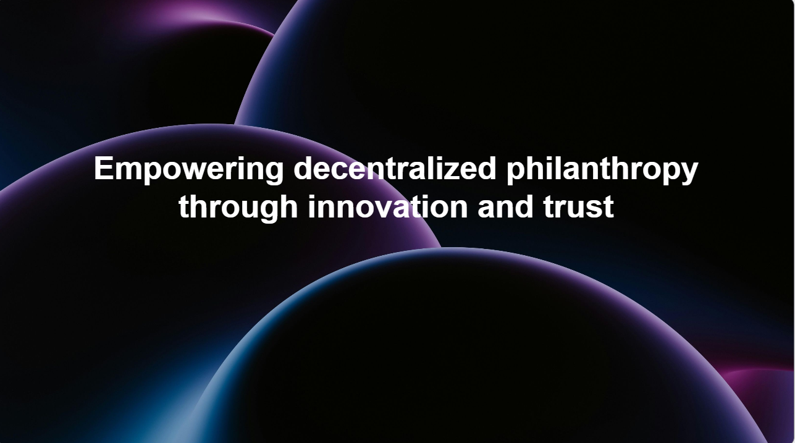

Slide 2
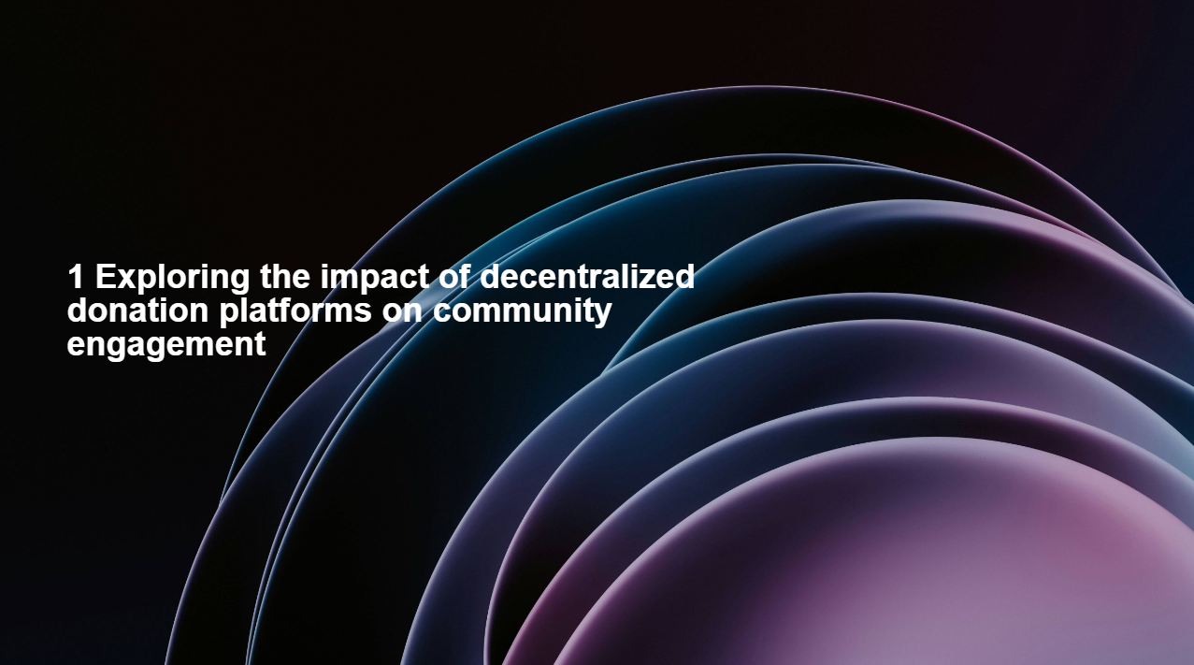

Slide 3
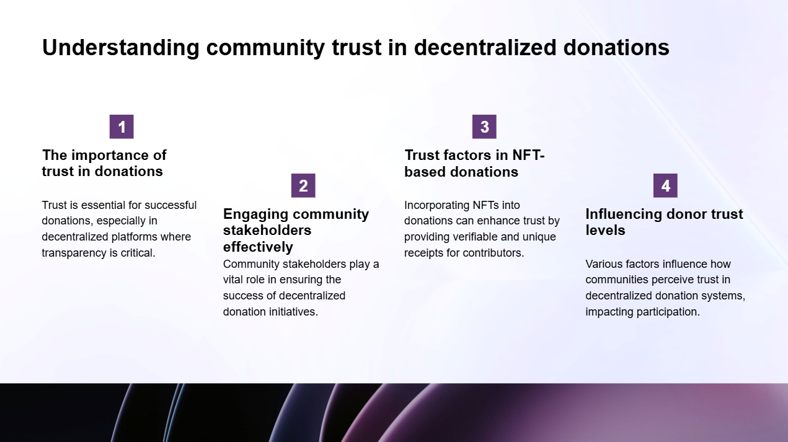

Slide 4
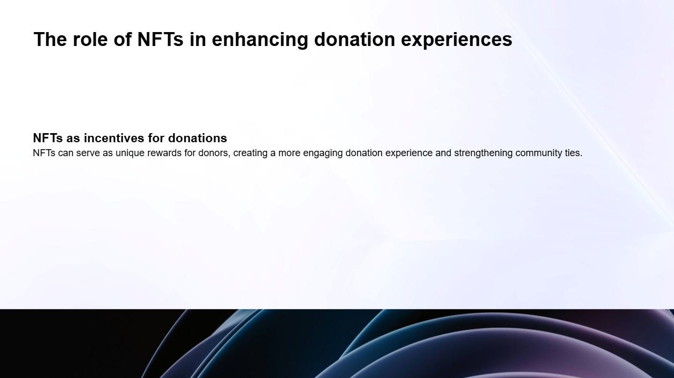

Slide 5
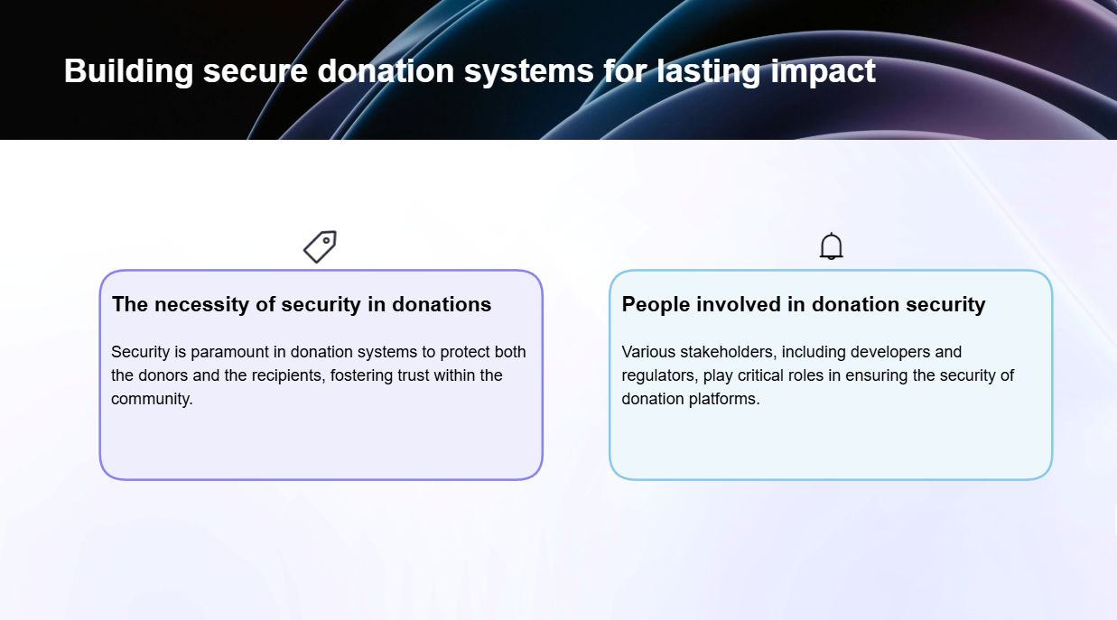

Slide 6
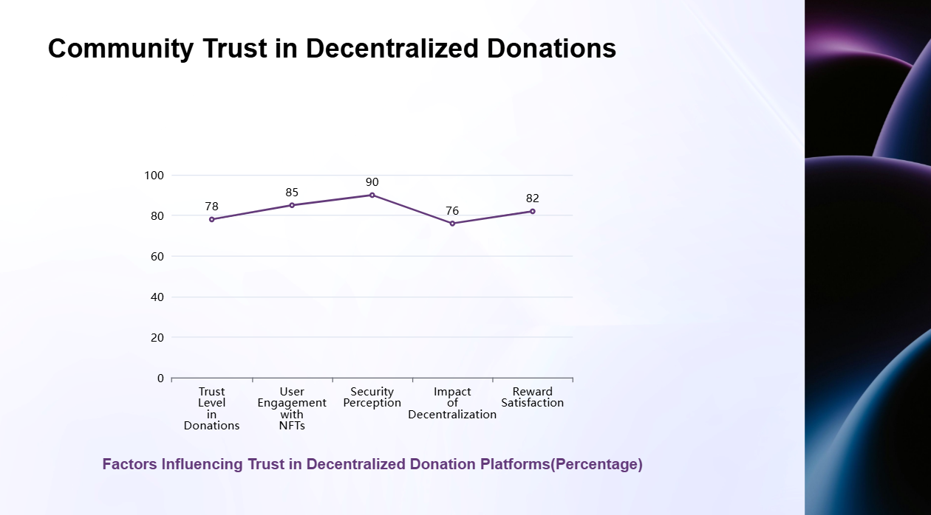

Slide 7


Slide 8
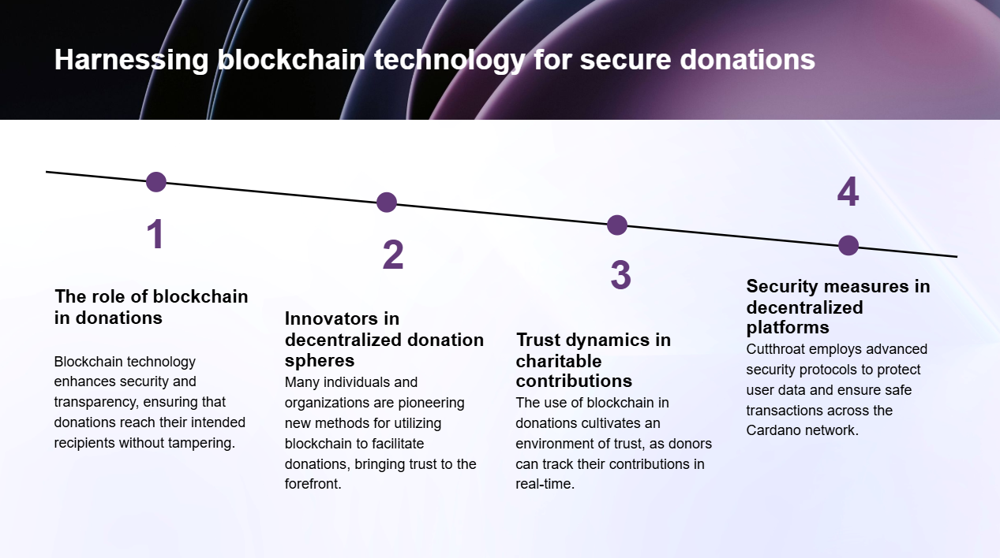

Slide 9
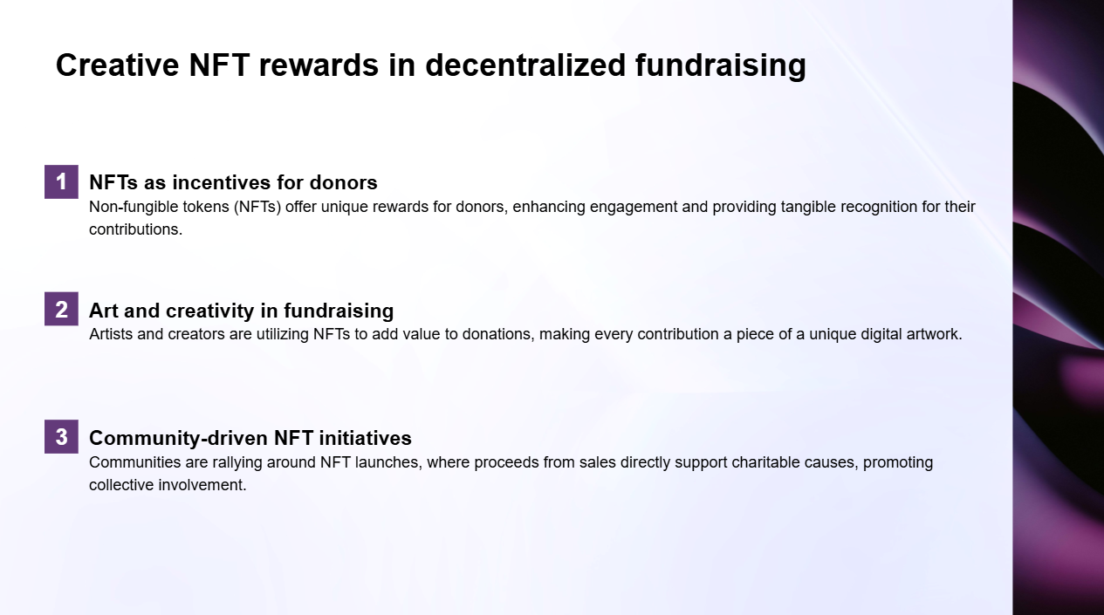

Slide 10
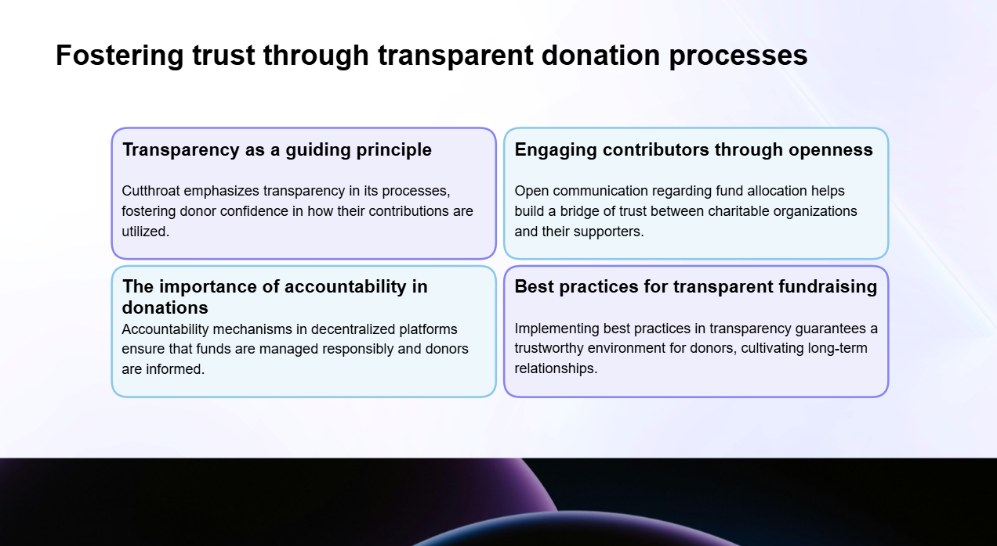

Slide 11
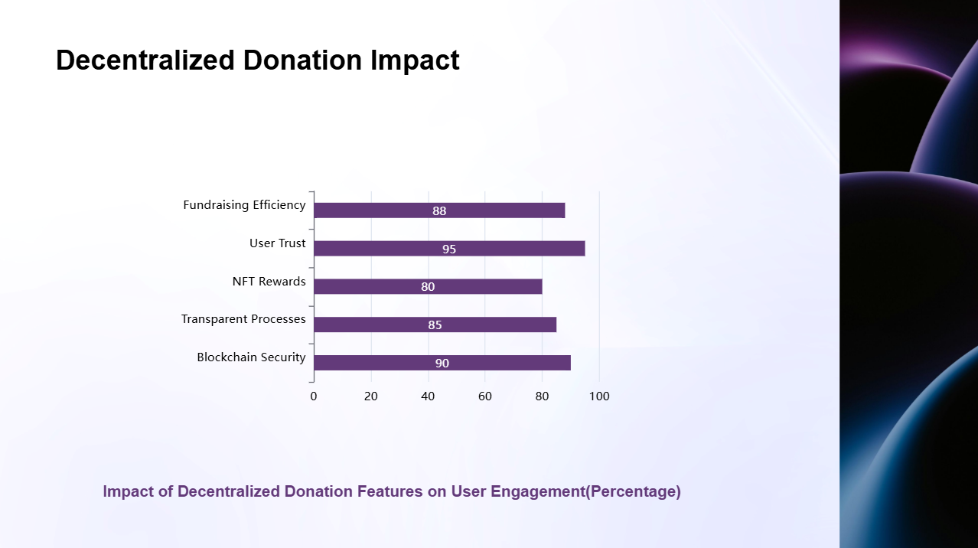

Slide 12
Team members Adithya (L) - Lead Developer & Project Architect Sathya Sai - Blockchain Integration Specialist Surya Guttapalli - Frontend Developer & UI/UX Designer Sai Charan Koganti - Smart Contract Developer Saketh Mantol - Infrastructure Manager

Slide 13


